Slide 1
Adidas Coding Challenge
Fernando Gros González

Slide 2
Table of contents
Architecture overview
Meeting the SLAs
Test solution to demonstrate the approach
Overview
API Documentation
Team Structure
Bonus 1: CI/CD proposal
Bonus 2: Architecture to deploy in Kubernetes

Slide 3
Architecture Overview

Slide 4







Architecture Overview
Internet Gateway
Availability Zone A
Availability Zone B
Public Subnet
API GATEWAY
On the right we present the architecture designed for the challenge overview. Following a brief description of the diagram:
Cloud-Native micro-services architecture:
Virtual private Cloud
A public subnet where we expose our API gateway through an internet gateway.
Two availability zones in two isolated regions for security and high availability reasons.
A NAT gateway for each availability zone, that will inform the internet gateway about the cluster health.
A Private subnet to host the load balancer.
A Private subnet to host a Kubernetes cluster that will host the micro services.
Only the public subscriptions service will expose an endpoint to the outer world.
In that same subnet we will host a kafka cluster, all the internal communications will be through kafka. So that the private micro services will not expose any endpoints through the gateway.
At last, another private subnet to host the databases. That way we can apply special security policies to our data.
NAT GATEWAY
NAT GATEWAY
PrivateSubnet
Load Balancer
Private app Subnet
Public subscriptions service
Public subscriptions service
Privatesubscriptions service
Privateemail service
Privatesubscriptions service
Private email service
Private data Subnet

Slide 5
Meeting the SLAs

Slide 6
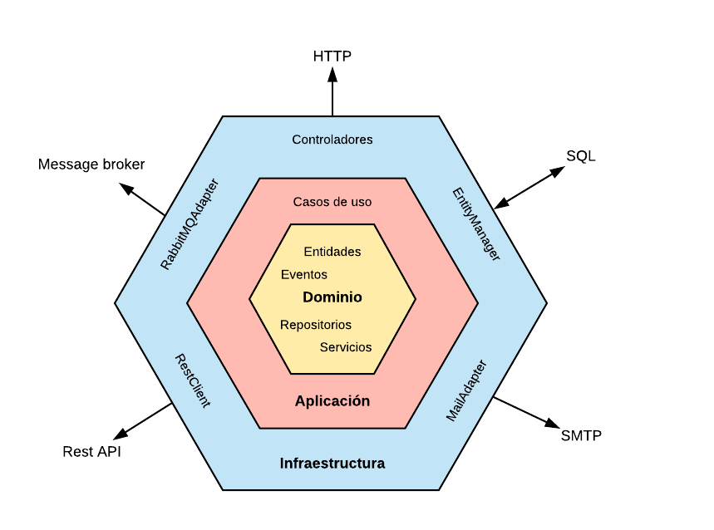

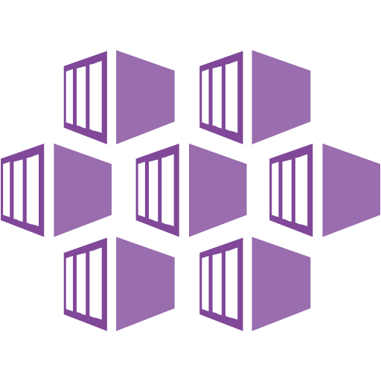
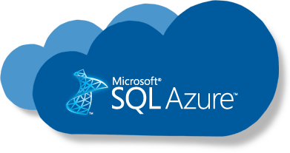
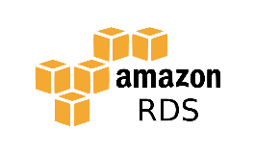
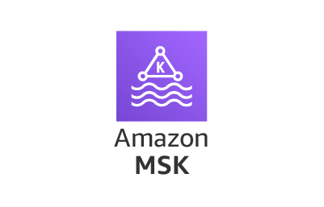
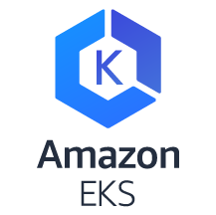
Meeting the SLAs
The SLAs for our service can be classified in two main groups:
Low Response Time and High Availability
Public Service: Response time 100ms, Up time: 99,99%
Subscription Service: Response time 150ms, Up time: 99,99%
High Response Time and Medium Availability
Email Service: Response time 60 sec, Up time: 85%
Low Response Time and High Availability
To achieve High availability in our services we need to consider 3 main points:
High availability of the cluster (K8s): Configure K8s in high availability mode, a multi-master cluster to manage the worker nodes.
High availability of the messaging system (kafka): Kafka provides high availability by means of replication. It replicates the log for each topic's partitions across a configurable number of servers allowing high availability and automatic failover to these replicas when a server in the cluster fails, so messages remain available in the presence of failures.
High availability of the database: Configure a standby replica in a different availability zone with synchronous data replication.
Despite what we just mentioned, the truth is that nowadays cloud providers offer managed services for all the mentioned services that will handle high availability by themselves (or with simple-friendly configurations). From the cost-effective point of view, it is usually recommended to go for managed services. Azure and AWS for instance provide managed services for all of the above: EKS, AKS, Azure hdinsight, AWS MSK, Azure Database, AWS RDS.
On the other hand, to achieve low response times it is more a matter of resources of the cluster and efficient development.
The approach is to use horizontal pod autoscaler in the K8s cluster, an hexagonal architecture approach for our
micro services design and kafka for all communications among them.

Slide 7
Meeting the SLAs
High Response Time and Medium Availability
For the email service, we have a more relaxed SLA, so we can configure it in different ways that allow us to save costs. The main point is that this will be a 100% asynchronous service. That means that it will not expose any APIs to the other services in the cluster, it will just fetch messages from topics an trigger the business logic from there.
Since we have some more relaxed SLA policies here, we can configure the Email service kafka consumer to fetch data in bulk, configuring the minimum amount of data we want per fetch and, of course, limiting the maximum time we are willing to wait for that kind of data to accumulate. For that, we will use this two kafka consumer configurations:
fetch.min.bytes: This property allows a consumer to specify the minimum amount of data that it wants to receive from the broker when fetching records. If a broker receives a request for records from a consumer but the new records amount to fewer bytes than fetch.min.bytes, the broker will wait until more messages are available before sending the records back to the consumer. This reduces the load on both the consumer and the broker as they have to handle fewer back-and-forth messages in cases where the topics don’t have much new activity (or for lower activity hours of the day).
fetch.max.wait.ms: By setting fetch.min.bytes, you tell Kafka to wait until it has enough data to send before responding to the consumer. fetch.max.wait.ms lets you control how long to wait. By default, Kafka will wait up to 500 ms. For instance, if you set fetch.max.wait.ms to 100 ms and fetch.min.bytes to 1 MB, Kafka will receive a fetch request from the consumer and will respond with data either when it has 1 MB of data to return or after 100 ms, whichever happens first.
We could, for instance, set fetch.min.bytes to 20MB and fetch.max.wait.ms to 30 seconds. That way we reduce the load by increasing latency (which is okay in our scenario), making the resource consumption lower for our service.
In terms of the availability of the 85%, the truth is that we could just do nothing and let the service be available 99,99% of the time like the rest of the services, or go for a more conservative solution and de-provision the pods during late night hours (85% of availability would allow us to turn off our service for almost 4h a day). In terms of cost optimization, the second approach would be better, but it would be an operational risk and some mechanism should be putted in place to make sure that the service is provisioned properly later.

Slide 8
Test solution to demonstrate the approach
Overview

Slide 9
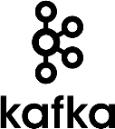
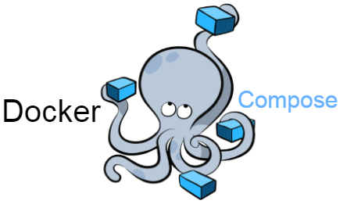

Overview
10
1
Micro services:
Java 11
Spring boot 2.3.4
Maven 3.6.3
Http Response
POST /subscriptions
Public subscriptions service
2
Validations (formats and contents)
Extract the Id from the message, if it is null respond with and exception, if it has value return it as a successful response
9
Kafka request/reply communication. Consume a message to “create_subscription_response” topic
8
3
Kafka request/reply communication.
Produce a message to “create_subscription” topic
Produce a message to “welcome_email” topic (this is the topic that the email service should consume)
Kafka request/reply communication.
Produce a message to “create_subscription_response” topic
7
4
Kafka request/reply communication.
Consume message from “create_subscription” topic
Private subscriptions service
5
Validations (Business, Is email already subscribed to that campaign?)
6
Persist if validations are okay

Slide 10
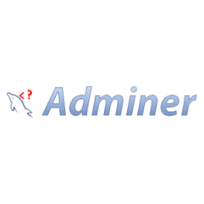



Overview
version: '3.1' services: zookeeper-server: image: 'bitnami/zookeeper:latest' ports: - '2181:2181' environment: - ALLOW_ANONYMOUS_LOGIN=yes kafka-server: image: 'bitnami/kafka:latest' ports: - '9092:9092' - '9093:9093' environment: - KAFKA_CFG_ZOOKEEPER_CONNECT=zookeeper-server:2181 - ALLOW_PLAINTEXT_LISTENER=yes - KAFKA_CFG_LISTENER_SECURITY_PROTOCOL_MAP=CLIENT:PLAINTEXT,EXTERNAL:PLAINTEXT - KAFKA_CFG_LISTENERS=CLIENT://:9092,EXTERNAL://:9093 - KAFKA_CFG_ADVERTISED_LISTENERS=CLIENT://kafka-server:9092,EXTERNAL://localhost:9093 - KAFKA_INTER_BROKER_LISTENER_NAME=CLIENT depends_on: - zookeeper-server db: image: postgres ports: - '5432:5432' restart: always environment: POSTGRES_PASSWORD: root POSTGRES_USER: root POSTGRES_DB: subscriptions subscriptions-service: image: 'fernandogrgo/code_challenge:subscriptions' ports: - '8080:8080' environment: - JAVA_OPTIONS=-Dspring.profiles.active=docker -DKAFKA_HOSTNAME=kafka-server depends_on: - kafka-server - db subscriptions-internal-service: image: 'fernandogrgo/code_challenge:subscriptions-internal' ports: - '8081:8080' environment: - JAVA_OPTIONS=-Dspring.profiles.active=docker -DKAFKA_HOSTNAME=kafka-server -DDB_HOSTNAME=db depends_on: - kafka-server - db
docker-compose up -d
curl --location --request POST 'http://localhost:8080/subscriptions' \
--header 'Content-Type: application/json' \
--data-raw '{
"email": "user3633308@adidas.com",
"firstName": "John",
"gender": "MALE",
"dateOfBirth": "2000-10-23",
"consentAccepted": true,
"newsletterId": "3fa85f64-5717-4562-b3fc-2c963f66afa6"
}'
Recommended database and kafka clients:

Slide 11
Test solution to demonstrate the approach
API documentation

Slide 12

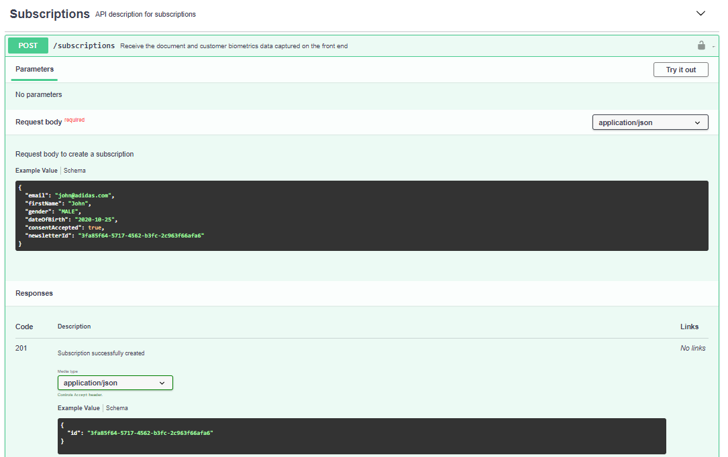
API documentation

Slide 13
Team Structure

Slide 14
Team Structure
Solutions Architect
Solution Design
Site Reliability Engineers (2)
System Operation
Tech Lead
Interaction with business stakeholders
Products/frameworks benchmarking
Technical decisions
Tasks automation
DevOps
Develop transversal components (i.e, framework)
Provide guidance and supervision to the team
Design
Collaborate with the solutions architect to make the most difficult decisions
Junior developers (2)
Participate in designs
Senior developer
Design
QA Engineer
Design test cases
Implement test cases automation
Develop simple tasks
Develop complex tasks previously design or with help/supervision
Perform manual tests when required
Scrum Master
Facilitator
Ensure methodology is being applied properly
Collaborate with the PO to enrich the backlog
Develop complex tasks
Provide guidance and supervision to junior developers

Slide 15
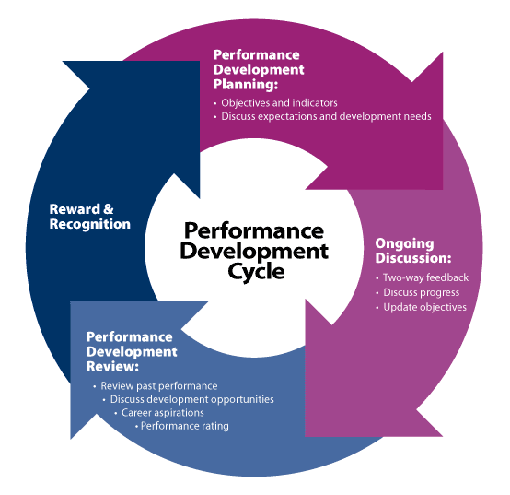
Team Structure: Career development strategy
In my experience the best way to provide the best career development is to make a personal assessment for every member of the organization. The key points should be:
1. Define goals for a period of time: This should be a conversation between the professional and the person who is leading him/her at the moment. It is also good to involve other teammates or people in other teams sometimes to provide inputs.
2. Continuous feedback: During the whole period of time, both the professional and the people involved should stablish a two-way feedback system (formal/informal conversations). The professional should own his/her career, and seek feedback if he/she feels he/she is not receiving it.
3. Evaluate the period of time: This should be a conversation with the people that have been involved during the period of time, to exchange impressions, points of view and opinions. Healthy debates, transparency and openness are really helpful to properly manage the expectations of all parties.
4. Recognition: After the evaluation, the professional should be rewarded if he/she has improved, either by assuming more responsability, or being better or more efficient in his/her work.
At last, the loop should start again at point 1.

Slide 16
Bonus 1: CI/CD proposal

Slide 17

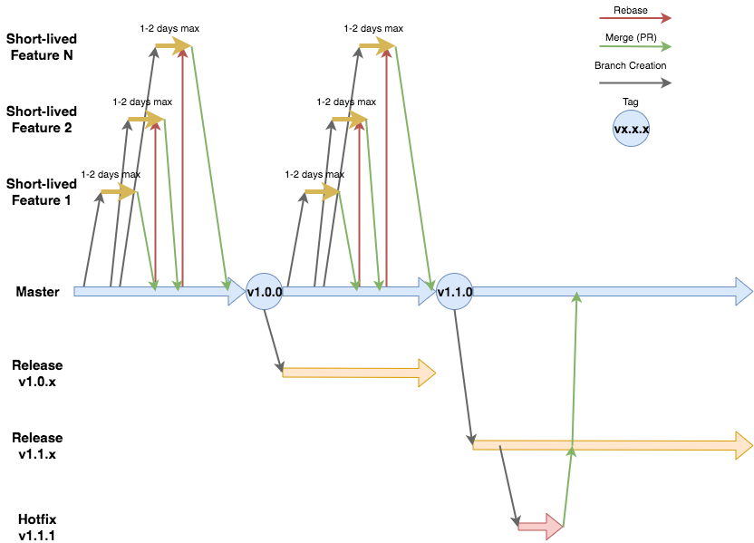
CI/CD proposal: CI
For every repository the branches model will be Trunk Based Development (TBD). These are the main features of this model:
Master becomes a protected branch where you can only merge to but not push to.
All merges get tested and reviewed.
Features or fixes are implemented in short lived branches that are also tested. These branches are merged once a day after tests pass. If a feature is not finished it gets turned off with feature toggles before merging back to the main branch to be picked up again later.
When merging a feature to trunk you squash the commits on the feature branch and keep the message as descriptive as possible, of the work you have done. This is to avoid messy histories that show all of the tiny little changes in the feature or fix branches before merging.
Using feature toggles, you can keep merging to the main trunk without breaking it because the feature can be disabled if it’s not finished. Another advantage of this is that you can enable A/B testing, turning on the feature for some users and not others.
Whenever deploying to production, you can create an annotated tag style vx.x.x and this can be deployed to production by an authorized party. Another approach is to have release branches for this, which is the one that we will use.
Hotfixing will be conducted in the release branches and merged into master after testing and deploying.
Image extracted from a similar design I made in the past for another client.

Slide 18
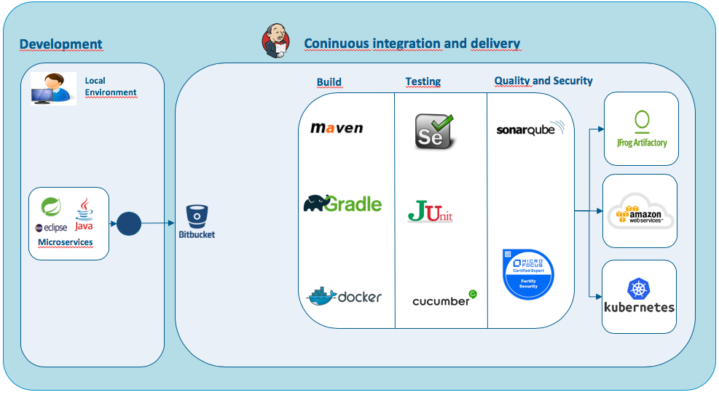
CI/CD proposal: CD
The intention is to use Jenkins as the principal tool for the CI/CD process by designing a pipeline that can cover all the phases of the process:
1. Trigger a build when a commit is made to master.
2. Build the artifact (jar)
3. Run the unit tests
4. Run static analysis of code for both quality and security breaches.
5. Generate a docker image.
6. Deploy the image in an ephemeral environment and run the regression and integration tests.
7. Deploy the artifact to the artifact repository.
8.Deploy the image to the staging/UAT environment.
Image extracted from a similar design I made in the past for another client.

Slide 19
Bonus 2: Architecture to deploy in Kubernetes

Slide 20
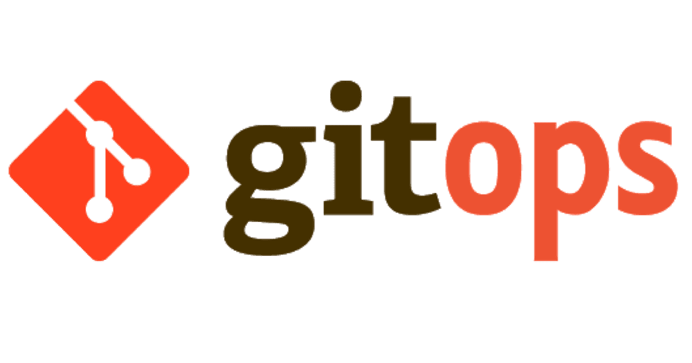


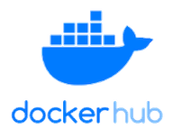



Bonus 2: Architecture to deploy in Kubernetes
Flux Scans every “X” seconds the docker registry for new images builds
git push
Trigger build
Push new tag
Build, test, package and generate docker image
If a new image is detected a deployments is triggered automatically
The proposal is to use a gitops approach, meaning that a commit in master will trigger the whole CI/CD pipeline and end-up with the new versions deployment in the staging environment.
In order to do so, we will also have the kubernetes config files (HelmRelease and ConfigMap mainly) for every namespace also in git repositories. Then, using flux, we can monitor all relevant image repositories, detect new images, triggers deployments and update the desired running configuration based on that.
It basically modifies and commits the helm release files in git (if enabled), to change the tag version whenever it detects a change in the image repository. Also using its internal cluster operator it triggers deployments inside kubernetes to ensure git and cluster configurations match.
The benefits are: you don't need to grant your CI access to the cluster, every change is atomic and transactional, git has your audit log. Each transaction either fails or succeeds cleanly. You're entirely code centric and don't need new infrastructure.

